Slide 1
SECURE DATA HIDING IN IMAGES USING STEGANOGRAPHY
CAPSTONE PROJECT
Presented
By
Siri Ramineni
College Name : Institute of Aeronautical Engineering
Department : Computer Science and Engineering

Slide 2
OUTLINE
Problem Statement
Technology used
Wow factor
End users
Result
Conclusion
Git-hub Link
Future scope

Slide 3
Problem Statement
Develop a Python tool that utilizes steganography to embed secret messages within image files. The tool should provide a graphical user interface (GUI) for users to easily encrypt and decrypt messages.
Encryption modifies the least significant bits (LSB) of image pixels to hide the message.
Decryption retrieves the hidden message from the modified image. Support for common image formats like PNG and JPG is required.

Slide 4
Technology used
Python: The primary programming language used for developing the
steganography tool
Tkinter: A standard GUI (Graphical User Interface) toolkit in Python used to create the
user interface for both encryption and decryption functionalities.
Pillow (PIL): A powerful image processing library in Python that allows for opening,
manipulating, and saving image files. It is used to handle image data for embedding
and extracting hidden messages.
Steganography Techniques: Least Significant Bit (LSB) Steganography: The technique employed to hide messages within the least significant bits of pixel values in images.

Slide 5
Wow factors
User-Friendly GUI: The project features a simple and intuitive graphical user interface
built with Tkinter, allowing users to easily encrypt and decrypt messages without
needing command-line knowledge.
Customizable Image Formats: Unlike many steganography tools that are limited to
specific image formats, this project supports multiple common formats such as PNG
and JPG, enhancing its versatility.
Least Significant Bit (LSB) Technique: The project utilizes the widely recognized LSB steganography method, which modifies only the least significant bits of pixel values, ensuring minimal visual alteration to the original image.

Slide 6
Wow factors
Delimiter for Message End: The implementation includes a unique delimiter that
signals the end of the hidden message, improving the accuracy of message extraction
during decryption.
Seamless Integration: The ability to both encrypt and decrypt messages within a
single application streamlines the user experience, making it easy to manage hidden
messages in images without requiring multiple tools.

Slide 7
End users
Cybersecurity Professionals
Law Enforcement Agencies
Intelligence Agencies
Digital Artists and Content Creators
General Users

Slide 8
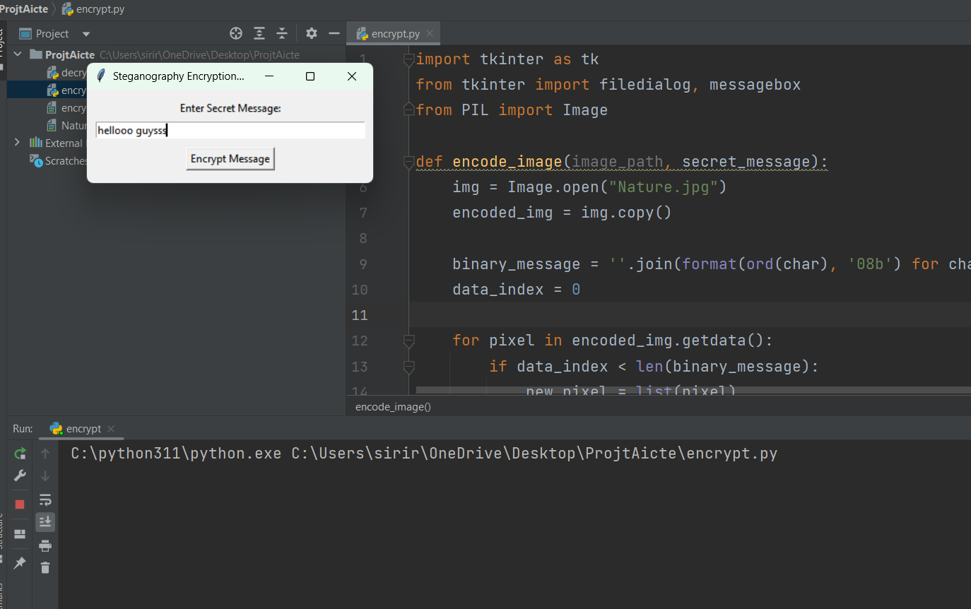
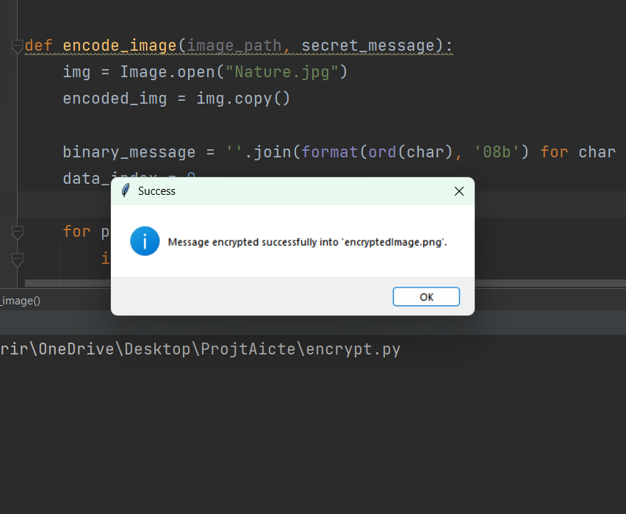
Results

Slide 9
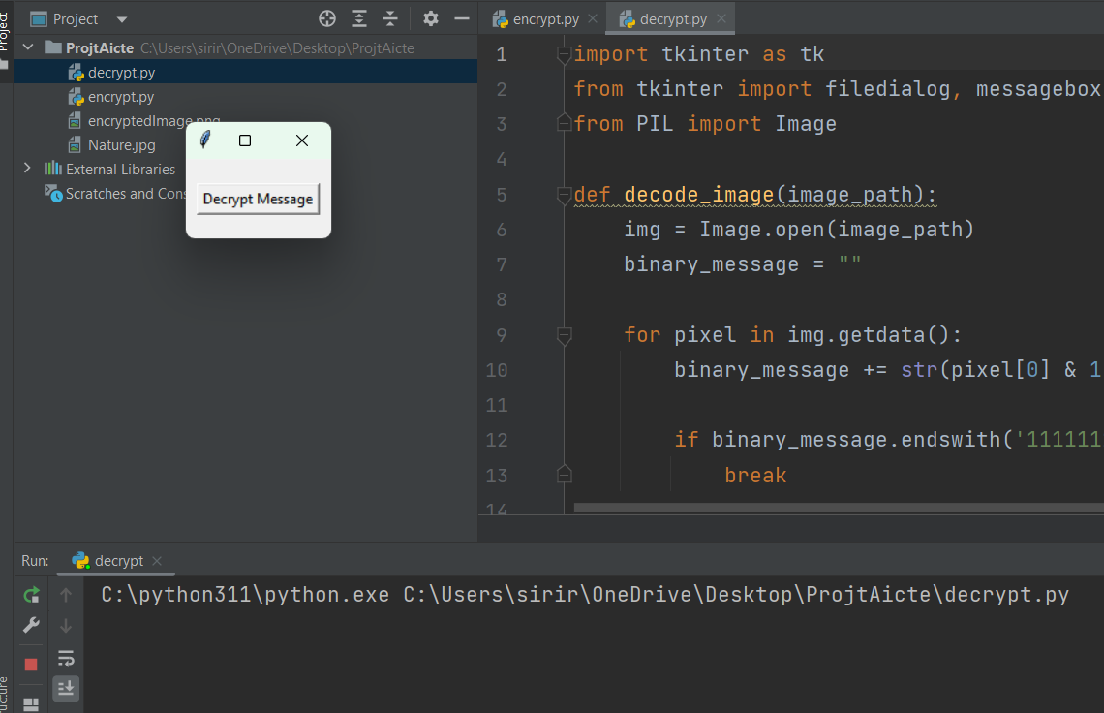
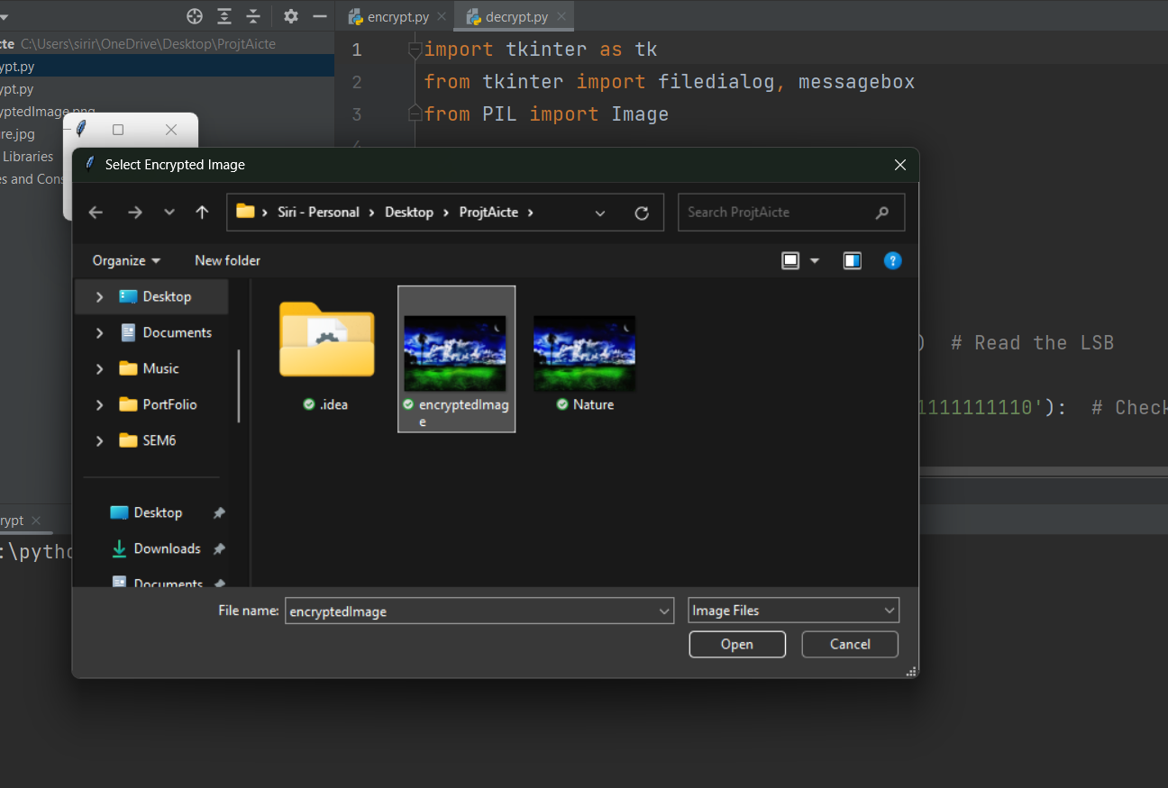
Results

Slide 10
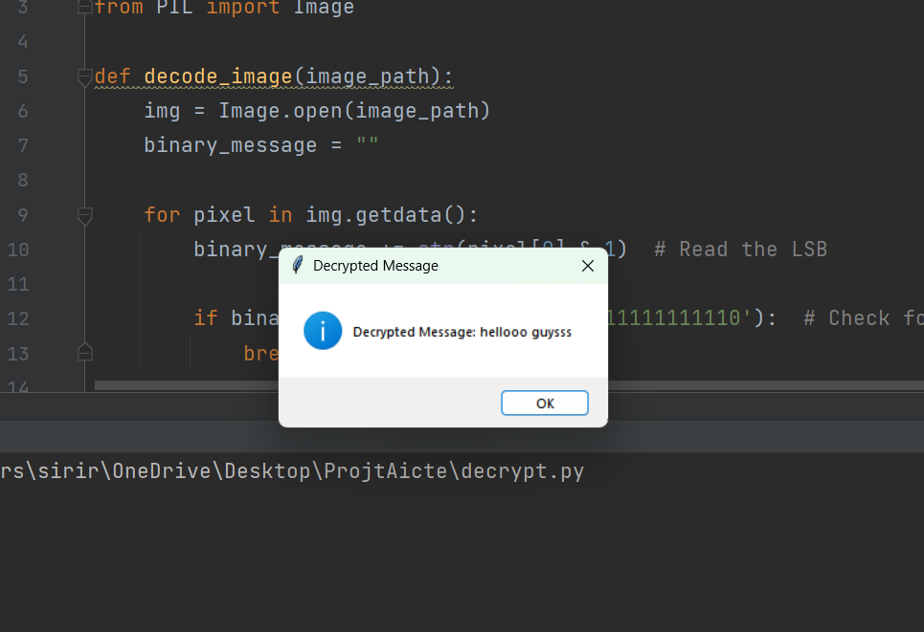
Results

Slide 11
Conclusion
The Steganography Tool addresses secure communication needs by embedding secret messages within images. It utilizes a user-friendly GUI, simplifying encryption via the LSB technique. This method ensures minimal visual alteration to original images while hiding data effectively. The project supports multiple image formats and employs a delimiter for accurate message retrieval. It serves diverse users, from cybersecurity professionals to individuals seeking private communication.
By encrypting and decrypting within a single application, it streamlines the user experience. The tool's implementation enhances usability and reliability in data handling. It demonstrates steganography's practical role in modern digital communication. As security concerns grow, this tool aids in protecting sensitive information and safeguarding privacy.

Slide 12
GitHub Link
https://github.com/SIRI-RAMINENI/Stega-Aicte-Project.git

Slide 13
Future scope(optional)
1. Al-Enhanced Steganography:
Al-powered design: Integrate Al to optimize the embedding process, making it harder
to detect 3 . This could involve Al analyzing images to find the least noticeable areas
for embedding data or creating photorealistic designs .
Adaptive Steganography: Use Al to adapt the steganography method based on the
image content and potential detection methods .
2. Enhanced Security:
Combine with Cryptography: Integrate traditional encryption methods with
steganography for a layered approach to security.
Steganalysis Detection: Add features to detect if an image has been altered by
steganography techniques.

Slide 14
THANK YOU

